Slide 1

Advanced Supervised Learning GBM and Deep Learning
Varadharajan Suresh
vs2769

Slide 2

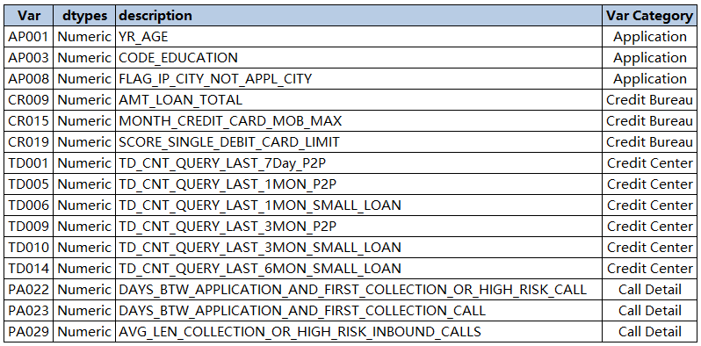

EDA
Data Dictionary
Newly created features
AP001_D_WOE, AP003_D_WOE, AP008_D_WOE, CR009_D_WOE, CR015_D_WOE,CR019_D_WOE, PA022_D_WOE, PA023_D_WOE, PA029_D_WOE,TD001_D_WOE, TD005_D_WOE, TD006_D_WOE, TD009_D_WOE,TD010_D_WOE, TD014_D_WOE

Slide 3
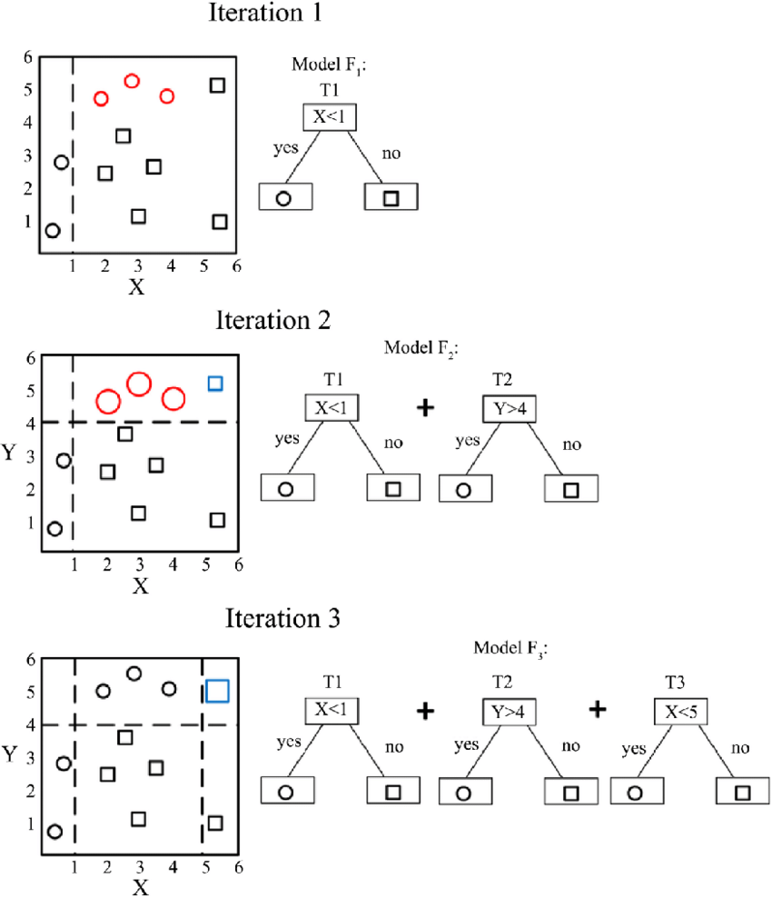
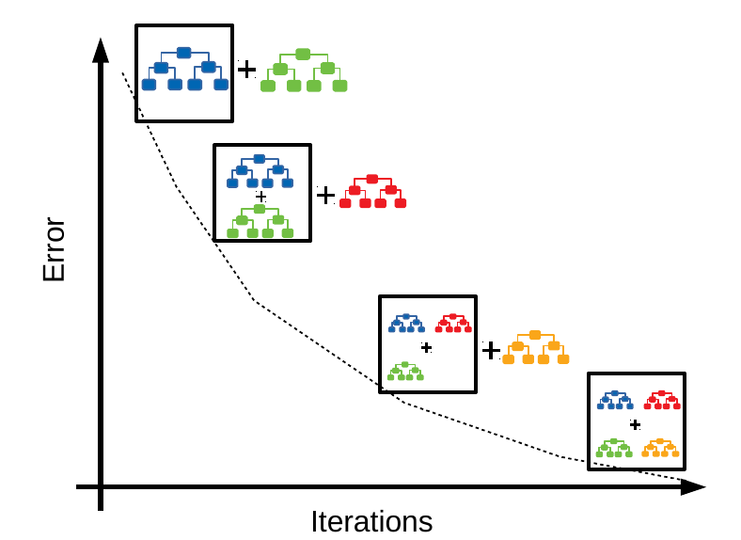
Modeling GBM
H2O is an opensource machine learning platform that facilitates you to build models based on data that you have.
What is GBM?
Gradient Boosting Machine is a forward learning ensemble method. The guiding heuristic is that good predictive results can be obtained through increasingly refined approximations. H2O’s GBM sequentially builds regression trees on all the features of the dataset in a fully distributed way - each tree is built in parallel.

Slide 4
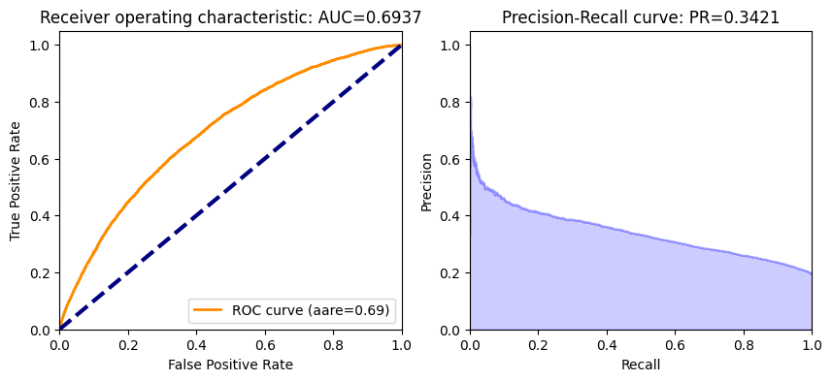
Modeling GBM
gbm_v1 = H2OGradientBoostingEstimator( model_id = 'gbm_v1’,
#ntrees = 300,
#nfolds=10,
#min_rows=20,
#sample_rate=0.70,
seed=1234)
model_id: The unique id assigned to the resulting model. If none is given, an id will automatically be generated.
Ntrees: A non-negative integer that determines the number of trees to grow.
Nfolds: Number of folds for cross-validation. If nfolds >= 2, then validation must remain empty.
min_rows: Minimum number of rows to assign to terminal nodes.
Sample_rate: The range is 0.0 to 1.0, and this value defaults to 1. Higher values may improve training accuracy. Test accuracy improves when either columns or rows are sampled.
Seed: Seed for random numbers (affects sampling) - Note: only reproducible when running single threaded

Slide 5
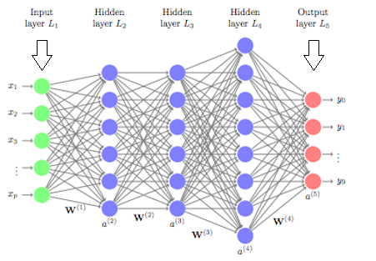
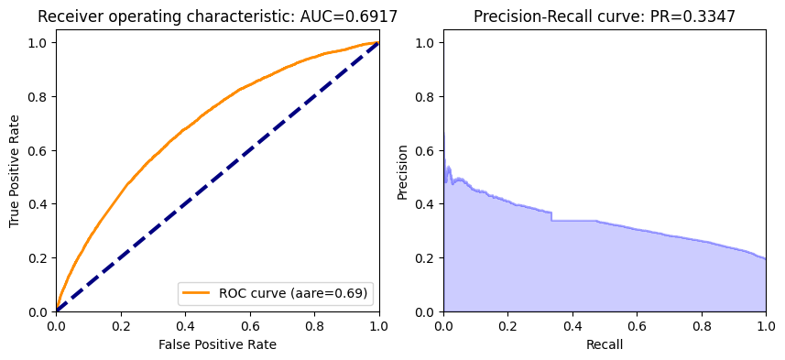
Modeling Deep Learning
H2O’s Deep Learning is based on a multi-layer feedforward artificial neural network that is trained with stochastic gradient descent using back-propagation. The network can contain a large number of hidden layers consisting of neurons with tanh, rectifier, and maxout activation functions.
d3 = H2ODeepLearningEstimator
(activation = 'Rectifier’,
hidden = [72,24,24,24,4],
seed = 414)

Slide 6
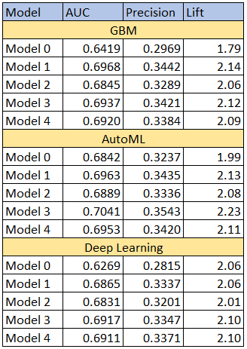
Summary
GBM: best performing model was model 3 which has the AUC of 0.6937, Precision of 0.3421 and lift of 2.12.
AutoML: best performing model was model 3 which has the AUC of 0.7041, Precision of 0.3543 and lift of 2.23.
DeepLearning: best performing model was model 3 which has the AUC of 0.6917, Precision of 0.3347 and lift of 2.10. The model consumes 144 features and hidden layers of [72,24,24,24,4].

Slide 7
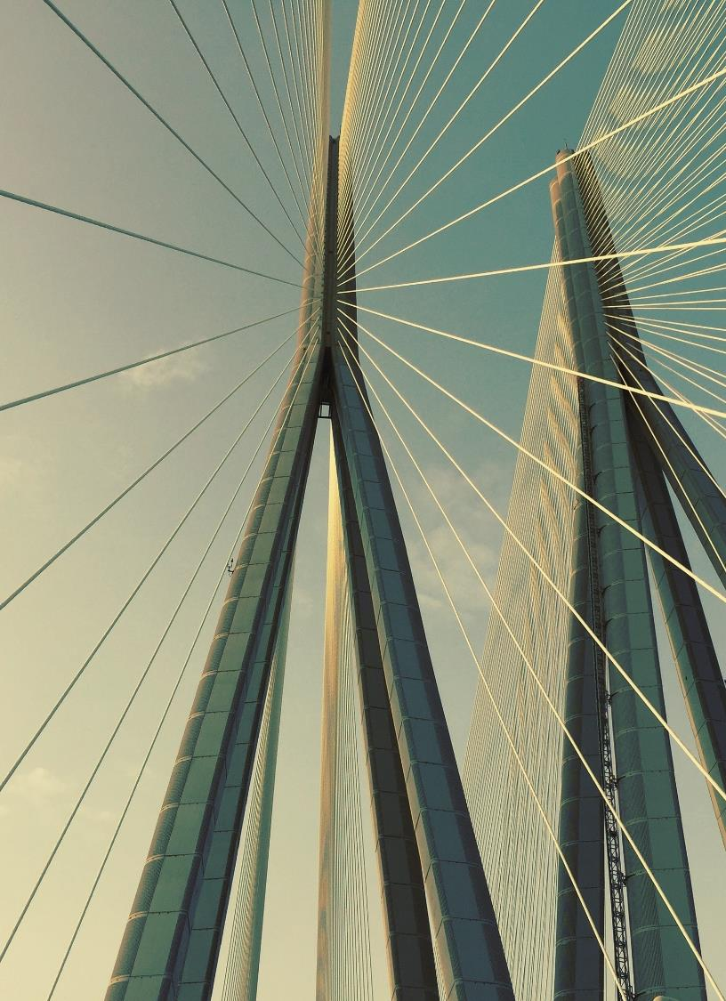

Thank you

